Slide 1
Internet Protocols

Slide 2
Learning Objectives
Explain the uses of computer networks in the home/at work and while on the move.
Define network hardware and network software and explain network protocols by which processes communicate.
Describe protocol stacks, the origin and relevance of the 7-layer OSI model.
Define the main role and importance of each of the layer in the OSI model.
Notes:
Students may not know exactly what is meant by globalization or may have an incomplete understanding of the term. You might ask students what they think it means. Potential answers could include: reduction of economic and cultural advantages of developed countries, increased number of companies with operations in multiple countries worldwide, and increased reliance on imports and exports of goods (and jobs). Globalization will be discussed in later slides as well.

Slide 3
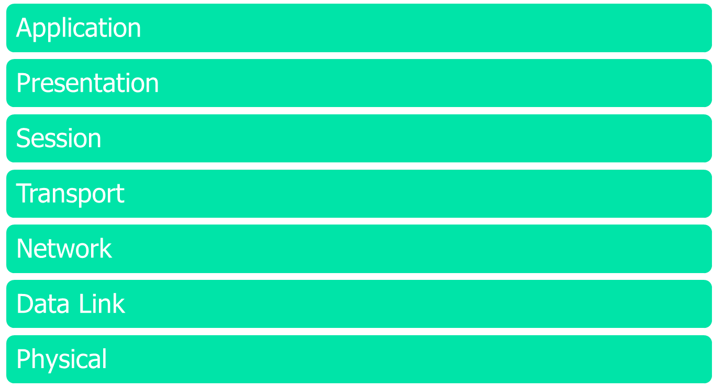
OSI Protocol Suite
Figure 1-1: The OSI Reference Model

Slide 4
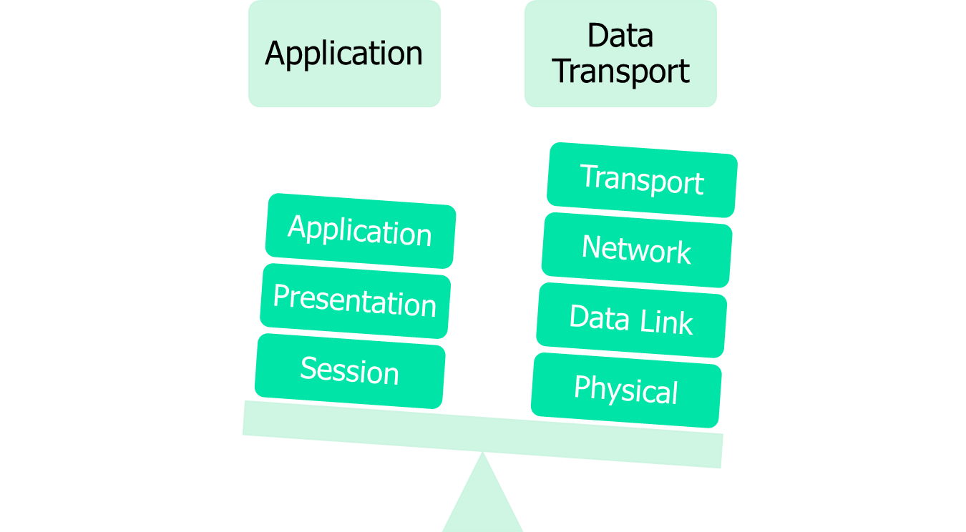
Two Sets of Layers
Figure 1-2: Two sets of the OSI Reference Model

Slide 5

Application Layer
Figure 1-3: The Application Layer

Slide 6
Application Layer…
The application layer is the OSI layer closest to the end user, which means that both the OSI application layer and the user interact directly with the software application.
This layer interacts with software applications that implement a communicating component. Such application programs fall outside the scope of the OSI model. Application layer functions typically include identifying communication partners, determining resource availability, and synchronizing communication. .

Slide 7
Application Layer…
Some examples of application layer implementations include Telnet, File Transfer Protocol (FTP), and Simple Mail Transfer Protocol (SMTP), DNS, Web/Http.

Slide 8





Application Layer…
Client - Server
Peer-to-Peer
Figure 1-4: A client-server vs. a peer-to-peer configuration

Slide 9
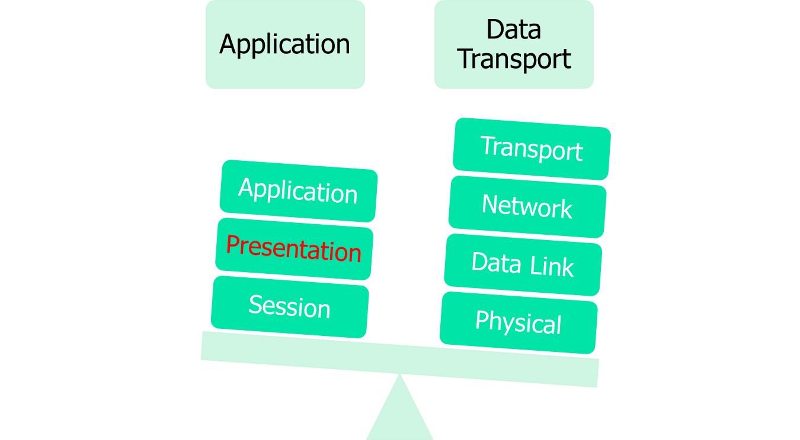
Presentation Layer
Figure 1-5: The Presentation Layer

Slide 10
Presentation Layer…
The presentation layer provides a variety of coding and conversion functions that are applied to application layer data. These functions ensure that information sent from the application layer of one system would be ‘readable’ by the application layer of another system.
Some examples of presentation layer coding and conversion schemes include common data representation formats, conversion of character representation formats, common data compression schemes, and common data encryption schemes.

Slide 11
Presentation Layer…
Protocols considered to belong to this level (perhaps not strictly):
AFP, AppleShare File Protocol
GIF, GIF
ICA Citrix Systems Core Protocol][1]
JPEG, Joint Photographic Experts Group
LPP, Lightweight Presentation Protocol
NCP, NetWare Core Protocol
NDR, Network Data Representation
PNG, Portable Network Graphics
TIFF, Tagged Image File Format
XDR, eXternal Data Representation
X.25 PAD, Packet Assembler/Disassembler Protocol

Slide 12
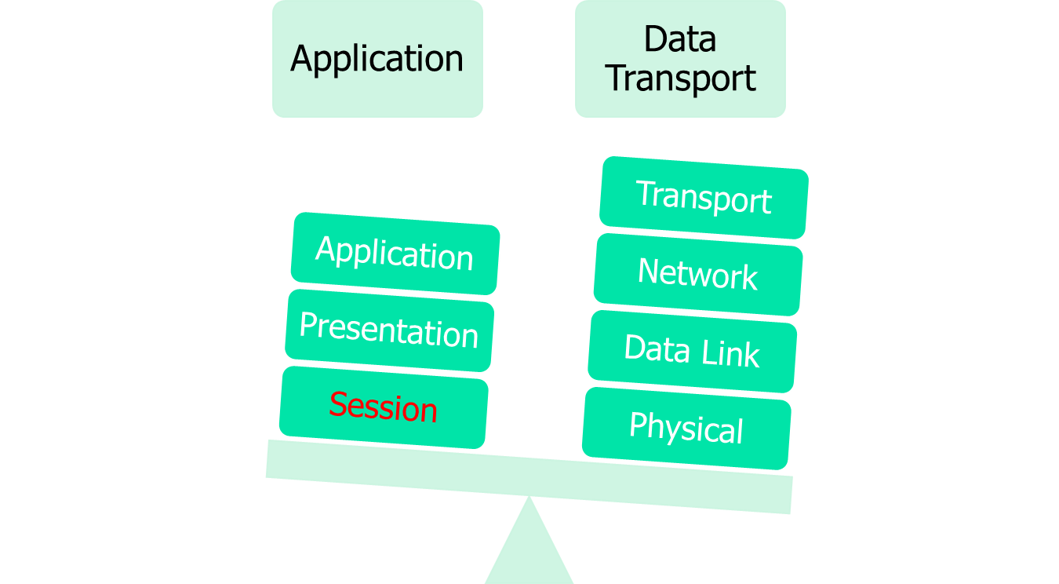
Session Layer
Figure 1-6: The Session Layer

Slide 13
Session Layer…
The session layer implementation of the OSI protocol suite consists of a session protocol and a session service. The session protocol allows session-service users (SS-users) to communicate with the session service.
An SS-user is an entity that requests the services of the session layer. Such requests are made at session-service access points (SSAPs), and SS-users are uniquely identified by using an SSAP address.

Slide 14
Session Layer…
Session service provides four basic services to
SS-users.
Establishes and terminates connections between SS-users and synchronizes the data exchange between them.
Performs various negotiations for the use of session layer tokens whish the SS-user must process in order to begin communicating.

Slide 15
Session Layer…
Inserts synchronization points in transmitted data that allow the session to be recovered in the event of errors or interruptions.
Enables SS-users to interrupt a session and resume it later at a specific point.

Slide 16

Transport Layer
Figure 1-7: The Transport Layer

Slide 17
Transport Layer…
The OSI protocol suite implements two types of services at the transport layer: connection-oriented transport service and connectionless transport service.
Five connection-oriented transport layer protocols exist in the OSI suite, ranging from Transport Protocol Class 0 through Transport Protocol Class 4. Connectionless transport service is supported only by Transport Protocol Class 4.

Slide 18
Transport Layer…
S.No. | Characteristics | Connectionless Service | Connection Oriented Service
1. | Example of Protocol | UDP (User Datagram Protocol) | TCP (Transmission control protocol)
2. | General Description | Simple, high-speed, low functionality "wrapper" that interfaces applications to the network layer. | Full-featured protocol that allows applications to send data reliably without worrying about network layer issues.
3. | Connection setup | Data is sent without setup i.e. connectionless. | Connection must be established prior transmission.
4. | Data interface to application | Message-based; data is sent in discrete packages by the applications. | Stream-based; data is sent by the application with no particular structure.
5. | Reliability and acknowledgments | Unreliable, best efforts delivery without acknowledgments. | Reliable delivery of messages; all data is acknowledged.

Slide 19
Transport Layer…
S.No. | Characteristics | Connectionless Service | Connection Oriented Service
6. | Examples of Protocol | UDP (User Datagram Protocol), IP. | TCP (Transmission Control Protocol), ATM, Frame Relay.
7. | Retransmission | Not performed. Application must detect lost data and retransmit if needed. | Delivery of all data is managed and lost data is retransmitted automatically.
8. | Feature provide to manage flow of data. | None | Flow control using sliding windows ; window size adjustment heuristics congestion avoidance algorithm.
9. | Transmission speed | Very high | Low
10. | Data quantity Suitability | Small to moderate amounts of data. | Small to very large amounts of data.

Slide 20
Transport Layer…
Transport Protocol Class 0 (TP0), the simplest OSI transport protocol, performs segmentation and reassembly functions. TP0 requires connection-oriented network service.
Transport Protocol Class 1 (TP1) performs segmentation and reassembly, and offers basic error recovery. TP1 sequences protocol data units (PDUs) and will retransmit PDUs or reinitiate the connection if an excessive number of PDUs are unacknowledged. TP1 requires connection-oriented network service.

Slide 21
Transport Layer…
Transport Protocol Class 2 (TP2) performs segmentation and reassembly, as well as multiplexing and demultiplexing of data streams over a single virtual circuit. TP2 requires connection-oriented network service.

Slide 22
Transport Layer…
Transport Protocol Class 3 (TP3) offers basic error recovery and performs segmentation and reassembly, in addition to multiplexing and demultiplexing of data streams over a single virtual circuit. TP3 also sequences PDUs and retransmits them or reinitiates the connection if an excessive number are unacknowledged. TP3 requires connection-oriented network service.

Slide 23
Transport Layer…
Transport Protocol Class 4 (TP4) offers basic error recovery, performs segmentation and reassembly, and supplies multiplexing and demultiplexing of data streams over a single virtual circuit. TP4 sequences PDUs and retransmits them or reinitiates the connection if an excessive number are unacknowledged.

Slide 24
Transport Layer…
TP4 provides reliable transport service and functions with either connection-oriented (e.g. ATM, Frame Relay) or connectionless network (e.g. IP, UDP) service. It is based on the Transmission Control Protocol (TCP) in the Internet Protocols suite and is the only OSI protocol class that supports connectionless network service.

Slide 25

Network Layer
Figure 1-8: The Network Layer

Slide 26
Network Layer…
The Network Layer provides the functional and procedural means of transferring variable length data sequences from a source to a destination via one or more networks while maintaining the QoS requested by the Transport Layer.
The Network Layer performs network routing, flow control, network segmentation/desegmentation, and error control functions.
Protocols include: IP(IPv4, IPv6), ARP, RARP, ICMP, IGMP, RSVP, IPSec.

Slide 27
Network Layer
Datagram network provides network-layer connectionless service.
Virtual Circuit (VC) network provides network-layer connection service.
Analogous to the Transport Layer services, but:
  service: host-to-host
  implementation: in network core
  choice: no concept of connection

Slide 28
Network Layer…
Virtual Networks
Datagram Networks
used to setup, maintain teardown VC
used in ATM, frame-relay, X.25
not used in today’s Internet
no call setup at network layer
routers: no state about end-to-end connections
  no network-level concept of “connection”
packets forwarded using destination host address
  packets between same source-dest pair may take different paths.

Slide 29

Data Link Layer
Figure 1-9: The Data Link Layer

Slide 30
Data Link Layer…
The Data Link Layer provides reliable transit of data across a physical network link.
Different Data Link Layer specifications define different network and protocol characteristics, including physical addressing, network topology, error notification, sequencing of frames, and flow control.
Physical addressing (as opposed to network addressing) defines how devices are addressed at the Data Link Layer.

Slide 31
Data Link Layer…
Network topology consists of the Data Link Layer specifications that often define how devices are to be physically connected, such as in a bus or a ring topology.
Error notification alerts upper-layer protocols that a transmission error has occurred, and the sequencing of data frames reorders frames that are transmitted out of sequence. Finally, flow control moderates the transmission of data so that the receiving device is not overwhelmed with more traffic than it can handle at one time.

Slide 32
Data Link Layer…
“link”
Figure 1-10: The ‘link’ in the Data Link Layer

Slide 33
Data Link Layer…
The Logical Link Control (LLC) sub layer of the data link layer manages communications between devices over a single link of a network. LLC is defined in the IEEE 802.2 specification and supports both connectionless and connection-oriented services used by higher-layer protocols.
IEEE 802.2 defines a number of fields in Data Link Layer frames that enable multiple higher-layer protocols to share a single physical data link.

Slide 34
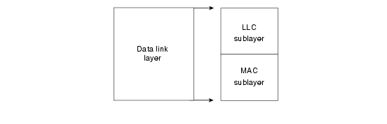
Data Link Layer…
The Media Access Control (MAC) sub layer of the Data Link Layer manages protocol access to the physical network medium. The IEEE MAC specification defines MAC addresses, which enable multiple devices to uniquely identify one another at the Data Link Layer.
Figure 1-11: The LLC and the MAC sub layers

Slide 35
Physical Layer
The Physical Layer defines the electrical, mechanical, procedural, and functional specifications for activating, maintaining, and deactivating the physical link between communicating network systems.
Physical Layer specifications define characteristics such as voltage levels, timing of voltage changes, physical data rates, maximum transmission distances, and physical connectors.

Slide 36
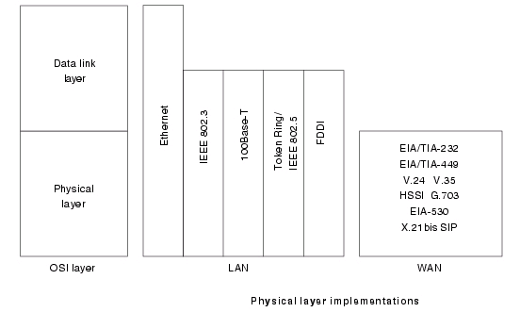
Physical Layer…
Physical Layer implementations can be categorized as either LAN or WAN specifications. Figure 1-12 below illustrates some common LAN and WAN Physical Layer implementations.
Figure 1-12: LAN/WAN Physical Layer Implementations

Slide 37
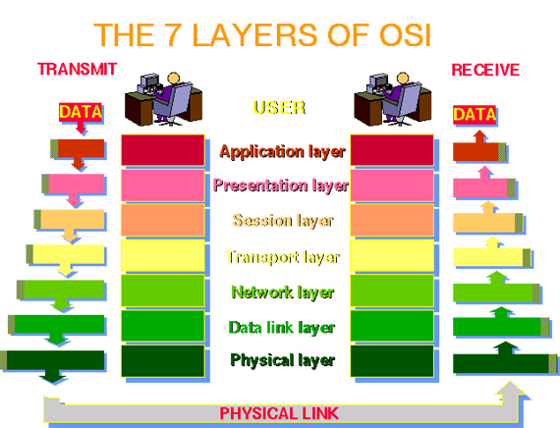
The OSI Reference Model - Data Flow
Figure 1-13: OSI Data Flow Model

Slide 38
Summary
OSI Reference Model:
Seven (7) Layers divided into two sets:
  Application
  Data Transport
Each has a specific role
The OSI Dataflow Model

Slide 39
Next Week……
Security

